Slide 1
CRM Product Business Unit
Enhanced Telecom Operations Map®
^{(eTOM)}

Slide 2
eTOM: Evolution
Started back in 1995, known then as the TOM. Based on traditional network management standards, it added the perspective of business process.
TOM very much focused on just the operational process needs.
Since starting in 1999, eTOM has gradually added strategic, marketing, and product lifecycle planning and Enterprise process elements.
Notes:
This slide will help readers understand the foundation and how eTOM has evolved.
Based on this information, we can see that when compare to traditional network standards there are large overlaps of fragments and terminology.

Slide 3
eTOM: Overview
Part of the New Generation Operations Systems and Software (NGOSS) program from the TeleManagement Forum. Hence, it supported by the TMF/NGOSS Compliance Program.
It’s the blueprint for process direction and the starting
point for development and integration of Business
and Operations Support Systems.
Enables effective communication and common vocabularies within Enterprise as well as with
customers and suppliers.
Notes:
How eTOM fits into the scheme of the New Generation Operations Systems and Software common to Telcos.

Slide 4

eTOM: in the context of NGOSS
Systems
Analysis &
Design
Solution
Design &
Integration
Shared Information & Data Model (SID)
Contract Interface &
Technology
Neutral Architecture
NGOSS
Supporting
Tools
Business Process Map (eTOM)
Compliance Tests
Business
Process Analysis
& Design
Conformance
Testing &
Deployment

Slide 5
eTOM: Objective
One of eTOM’s objectives is to aid the end-to-end automation of information and communications services for business and operations processes by using the holistic approach.
eTOM process framework for its entire value chain, including, for example, the service providers, customers, the software/hardware vendors, and system integrators.
Notes:
The object and scope of eTOM

Slide 6
eTOM: What is It?
It is a business process framework to guide the development and management of key processes within a telecommunications service provider.
i.e. Provides business-oriented view
  useful for planners/ managers/ strategists
  emphasizes structure/ process components/ process interactivity/ roles/ responsibilities
  sets requirements for (but is neutral towards) system solution/ architecture/ technology/ implementation
So, eTOM has two faces:
  business/ customer/ products
  solution/ system/ implementation

Slide 7
eTOM: What is it used for?
For telecommunications Service Provider
Provides a neutral reference point as they
consider internal process reengineering,
partnerships, alliances, and general working agreements with other providers.
For suppliers
Outlines potential boundaries of software
components, and the required functions, inputs,
and outputs that must be supported by products.

Slide 8
eTOM: What is it used for?
Represents industry-consensus on Service Provider processes
  harmonized position across global scene
  based on Member contributions
  must be tailored/ extended for individual companies
eTOM does not seek to constrain:
  organization
  differentiation
  implementation
eTOM is a framework for defining processes, not the final answer itself

Slide 9
eTOM: The Role of the eTOM
Provide guidance by offering a catalogue of industry-standard names, descriptions and scope, at multiple hierarchical levels, of all the Business Activities (or Process Elements) within a TSP.
Its functional coverage is still at a high level with respect to any detailed descriptions of key internal support services, including the management and delivery of IT services.
It is intentionally aimed at a broad coverage of activities within a Telecommunications Company, without documenting detail
Its purpose is to focus on the commonality between similar processes (whether for telephony, data, internet, mobiles, content etc), rather than delivering complete detail to guide implementation.

Slide 10
eTOM: Business Process Framework
Conceptual Structure
Customer
Strategy,
Infrastructure &
Product
Operations
Market, Product and Customer
Service
Resource
(Application, Computing and Network)
Supplier/Partner
Suppliers/Partners
Enterprise Management
Shareholders
Employees
Other Stakeholders
Notes:
The Operations Process Area is the heart of eTOM. It includes all operations processes that support the customer operations and management, as well those that enable direct customer operations with the customer. These processes include both day-to-day and operations support and readiness processes. The eTOM view of Operations also includes sales management and supplier/partner relationship management.
The Strategy, Infrastructure & Product Process Area includes processes that develop strategy, commit to the firm, build infrastructure, develop and manage products, and that develop and manage the Supply Chain. In the eTOM, infrastructure refers to more than just the IT and resource infrastructure that supports products and services. It includes the infrastructure required to support functional processes, e.g., CRM. These processes direct and enable Operations.
The Enterprise Management Process Area includes basic business processes required to run any business. These processes focus on Enterprise Level processes, goals and objectives. These processes have interfaces with almost every other process in the enterprise whether operational or product or infrastructure processes. These are sometimes considered corporate functions and/or processes, e.g., Financial Management, Human Resources Management processes, etc.
The Market, Product and Customer processes include those dealing with sales and channel management, marketing management, and product and offer management, as well as Customer Relationship Management and ordering, problem handling, SLA Management and billing.
Service processes include those dealing with service development and configuration, service problem management and quality analysis, and rating.
Resource processes include those dealing with development and management of the firm's infrastructure, whether related to products and services or to supporting the enterprise itself.
The Supplier/Partner processes include those dealing with the firm’s interaction with its suppliers and partners. This involves both processes that manage the Supply Chain that underpins product and infrastructure, as well those that support the Operations interface with its suppliers and partners.
Customers, to whom service is provided by means of the products sold by the enterprise: the focus of the business!
Suppliers, who provides products or resources used by the enterprise directly or indirectly to support its business
Partners, with whom the enterprise co-operates in a shared area of business
Employees, who work for the enterprise to pursue its business goals
Shareholders, who have invested in the enterprise and thus own stock
Stakeholders, who have a commitment to the enterprise other than through stock ownership.

Slide 11
eTOM: The Strategy, Infrastructure & Product area
“SIP” encompasses strategy and lifecycle management processes in support of operations
  Strategy & Commit
  Infrastructure Lifecycle Management
  Product Lifecycle Management
“SIP” also has functional groupings, aligned with those in “OPS”
Strategy, Infrastructure & Product
Strategy &
Infrastructure
Product
Commit
Lifecycle
Lifecycle
Management
Management
Marketing & Offer Management
Service Development & Management
Resource Development & Management
(Application, Computing and Network)
Supply Chain Development & Management

Slide 12
eTOM: The Operations area
Operations
“FAB” remains the core of the Operations area
Operations Support & Readiness is separated from FAB
“OPS” also supports functional process groupings shown as horizontal layers
Operations
Fulfillment
Assurance
Billing
Support &
Readiness
Customer Relationship Management
Service Management & Operations
Resource Management & Operations
(Application, Computing and Network)
Supplier/Partner Relationship Management

Slide 13
eTOM: The Enhanced Telecom Operations Map®
Customer
Strategy, Infrastructure & Product
Operations
Strategy &
Infrastructure
Product
Operations
Fulfillment
Assurance
Billing
Commit
Lifecycle
Lifecycle
Support and
Management
Management
Readiness
Marketing & Offer Management
Customer Relationship Management
Service Development & Management
Service Management & Operations
Resource Development and Management
Resource Management & Operations
(Application, Computing and Network)
(Application, Computing and Network)
Supply Chain Development and Management
Supplier/Partner Relationship Management
Source: TM Forum, 2004
Enterprise
Management
Strategic &
Brand Management,
Stakeholder & External
Disaster Recovery,
Enterprise
Market Research &
Relations Management
Security & Fraud
Planning
Advertising
Management
Financial &
Asset
Management
Human Resources
Research &
Enterprise Quality Mgt.,
Management
Development,
Process & IT Planning
Technology
& Architecture
Acquisition
Notes:
eTOM provides the Business View for NGOSS
Resume of the layers with horizontal & verticals – please note that horizontals are in line with the conceptual level
i.e. Service is the union of Service Development & Management + Service Management & Operations

Slide 14
eTOM: Enhanced Telecom Operations Map
The process structure in eTOM uses hierarchical decomposition, so that the business processes of the enterprise are successively decomposed in a series of levels. Process descriptions, inputs and outputs, as well as other key elements are defined. The eTOM process modeling depicts process flows in a vertical swim lane approach that drives end-to-end process and process flow-through between the customer and the supporting services, resources and supplier/partners.
Notes:
eTOM provides the Business View for NGOSS
Resume of the layers with horizontal & verticals – please note that horizontals are in line with the conceptual level
i.e. Service is the union of Service Development & Management + Service Management & Operations

Slide 15
eTOM: Enhanced Telecom Operations Map
Operations
Operations Support
& Readiness
Fulfillment
Assurance
Billing
Customer Relationship
Management
Customer Interface Management
Selling
CRM
Support &
Readiness
Problem
Handling
Customer
QoS / SLA
Management
Billing &
Collections
Management
Marketing
Fulfillment
Response
Order
Handling
Retention & Loyalty
Service Management & Operations
SM&O
Support &
Readiness
Service
Configuration
& Activation
Service
Problem
Management
Service Quality
Management
Service &
Specific Instance
Rating
Resource Management & Operations
Resource
Trouble
Management
Resource Performance Management
RM&O
Support &
Readiness
Resource
Provisioning
Resource Data Collection & Processing
Supplier/Partner Relationship Management
S/P
Buying
S/P Purchase
Order
Management
S/P Problem
Reporting &
Management
S/P
Performance
Management
S/P Settlements
& Billing
Management
S/PRM
Support &
Readiness
Supplier/Partner Interface Management

Slide 16
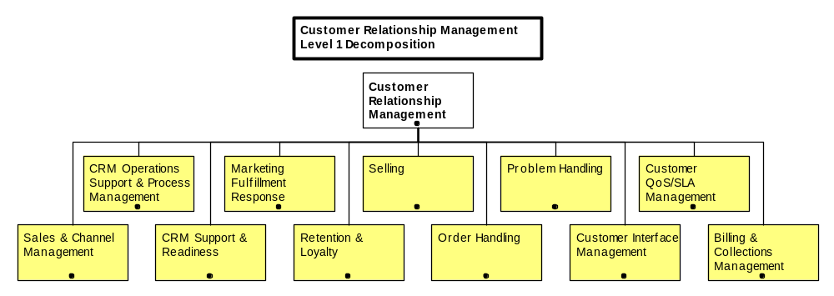
eTOM: Hierarchy Structure
Level 1 Decomposition

Slide 17
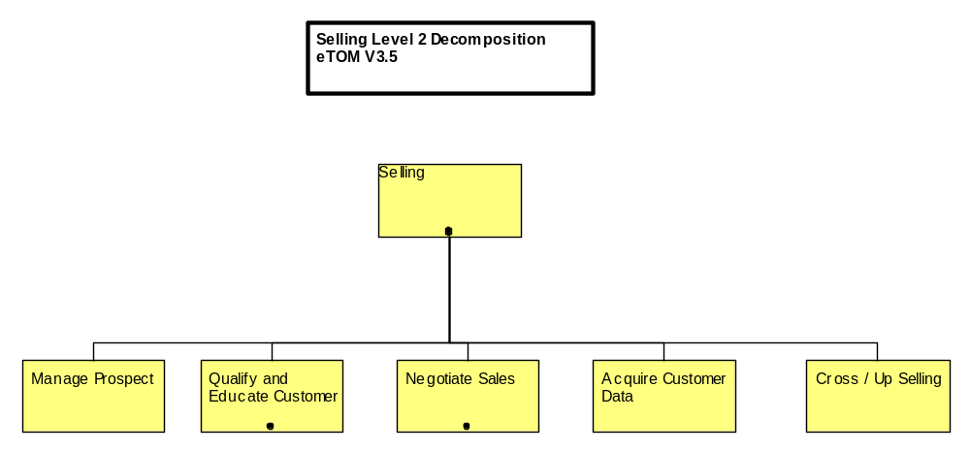
eTOM: Hierarchy Structure
Level 2 Decomposition

Slide 18
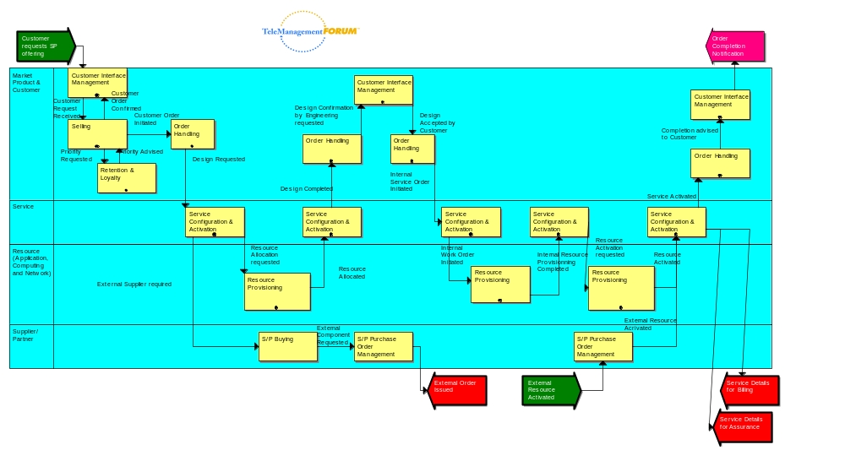
eTOM: Flow example

Slide 19
eTOM: eTOM and the ITIL Processes
Using eTOM to model the ITIL Processes
Since ITIL represents a best practice in IT Services to Telecommunication service providers, it is natural that ITIL terminology be used.
Telecommunication service providers are increasingly being asked to show that they comply with ITIL.
Hence, describe eTOM activities in ITIL terms is important for it’s acceptance in the Telecommunication service area. This can be done by modeling ITIL processes using eTOM Process Elements.

Slide 20
eTOM: Benefits
Business benefits of using the eTOM are:
  Scope - addressing all enterprise processes.
  identifies marketing processes to reflect their importance.
  identifies Enterprise Management processes and critical processes, thereby enabling acceptance.
  brings Fulfillment, Assurance and Billing (FAB) onto the high-level framework view.
  defines an Operations Support & Readiness vertical process grouping.
  recognizes process groupings, i.e., Strategy & Commit, Infrastructure Lifecycle Management and Product Lifecycle Management.
  recognizes strategy and lifecycle management processes
  moves from the older customer care or service orientation to a customer relationship management.
  acknowledges the need to manage resources across technologies.
  Recognizes enterprise interacts with external parties.

Slide 21
Using eTOM: Examples
Major US Service Provider using eTOM to clarify process implications for new projects under assessment - cost reduction from $4m to $160K achieved
Major European Service Provider using eTOM as a “neutral” process framework to arbitrate process disputes between internal Business Units
Major Australian Service Provider using eTOM as an “industry-standard” process framework to evolve its own business, and also drive system solutions and vendors to meet its needs
Major Asia-Pacific Service Provider comments its incumbent competitor changed from being known as poorly-managed to becoming a management reference, over the period when it applied eTOM in process improvement

Slide 22
eTOM Sample Case Study
URL for Sample CaseStudy Submitted on TMF
http://www.tmforum.org/browse.asp?catID=1660

Slide 23
Thank You
Enhanced Telecom Operations Map®
^{(eTOM)}

